Slide 1

CHICAGO CRIME ANALYSIS
BY PAVITHRA M

Slide 2
INTRODUCTION
A year ago in Chicago, the high incidence of crime prompted the government to take decisive action by launching an operation with top-performing police officers.
Now, as a year has passed since this decision, the government seeks to evaluate the reduction in crime cases and the advantages gained from this new operation.
The time taken for solving the cases and localities with higher crime rates are found and further measures to improve crime rate has been identified

Slide 3
ABOUT DATASET
The data contains Chicago Crime Information with 22 columns along with 90856 rows.
The dataset contains information like crime hotspot areas and few things that are highly confidential. Hence all those fields are encrypted into respective codes and analysed.
A few columns such as crime type ,crime date and updated on date is not encrypted which is main part of our analysis

Slide 4
objective
The main objective of the project is to evaluate the improvements in crime solving time and crime decreasing rate.
To identify the areas or localities in which high crime rate has been recorded.
To propose ideas by which the police department can decrease crime rates.
To identify the crime types which is recorded as the highest in all localities.

Slide 5
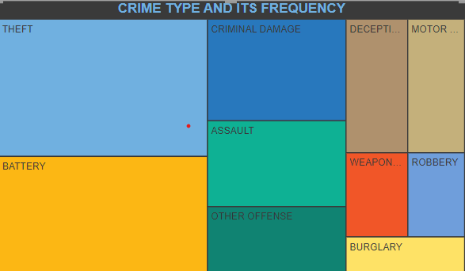
Theft is the highest recorded valued at 24.29% of total which is followed by Battery which stands at 20.55% out of 31 crimes.

Slide 6
Major findings
Total number of crimes-91K
Total number of domestic crimes-18k
Total number of crimes recorded-31
Average time taken -201.6
Arrest rate-12%
Domestic crime proportion analysis-19.84%

Slide 7
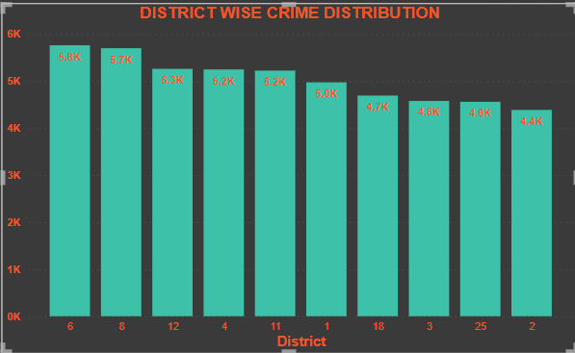
DISTRICT WISE CRIME DISTRIBUTION
The bar chart between the count of case number and district id’s it is clearly evident that the district number “6” is having highest number of cases (5.8K CASES) recorded in Chicago closely following by district number “8” (5.7K CASES).

Slide 8
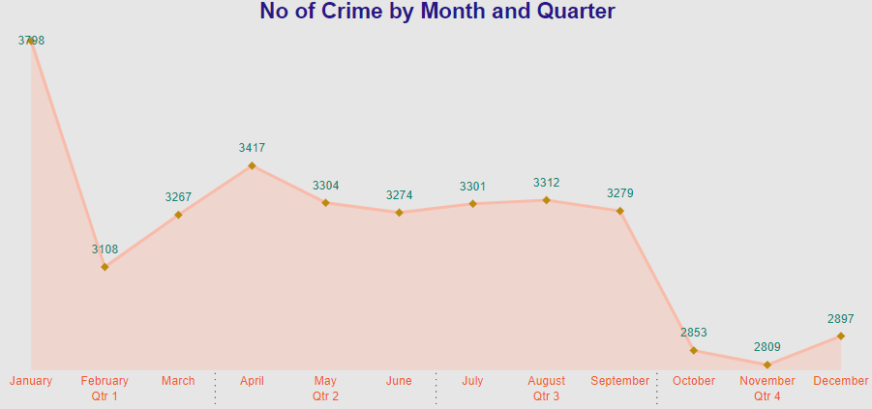
The crime recorded year is 2022. The above graph shows month and quarter wise distribution of crime
From the above graph, it is clearly evident that after Chicago police department intervention the crime count has been decreased and it is completely low in quarter 4 when compared to quarter 1.

Slide 9
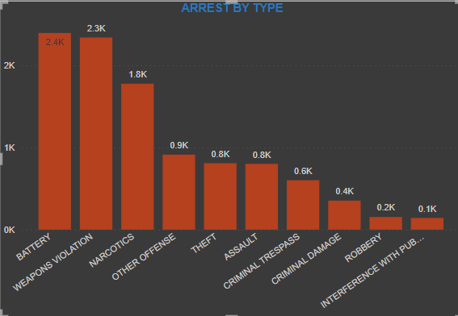
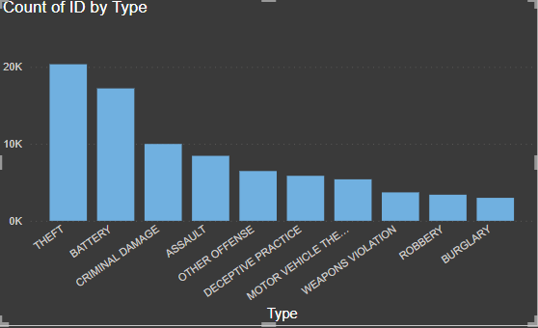
Crime type and its count

Slide 10
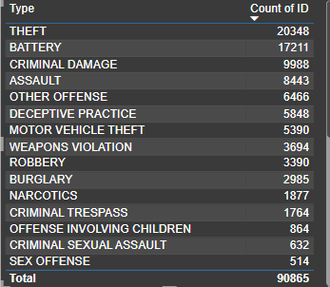
The above two bar charts and the table shows that the highest recorded crime is of theft type which is followed by battery
But in the number of arrest occurred rates states that the battery is the highly arrested crime followed by other crimes.
Out of 91K crimes reported in the Chicago city, major crime is theft and battery which accounts to almost 41% of crime.

Slide 11
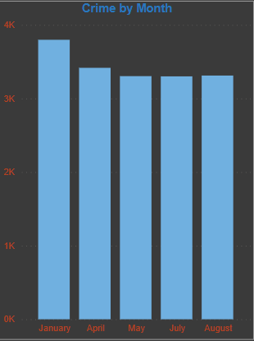
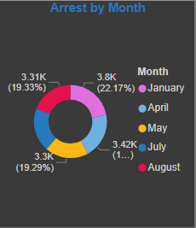
The highest crime recorded month is January which followed by April.
The same pattern is repeated in the arrest type as well.
From the above visualisations, it is clearly evident that the crime reported months are those in which the arrest is also happened high
So the actions taken by the police department is correct and hence it is proved.

Slide 12
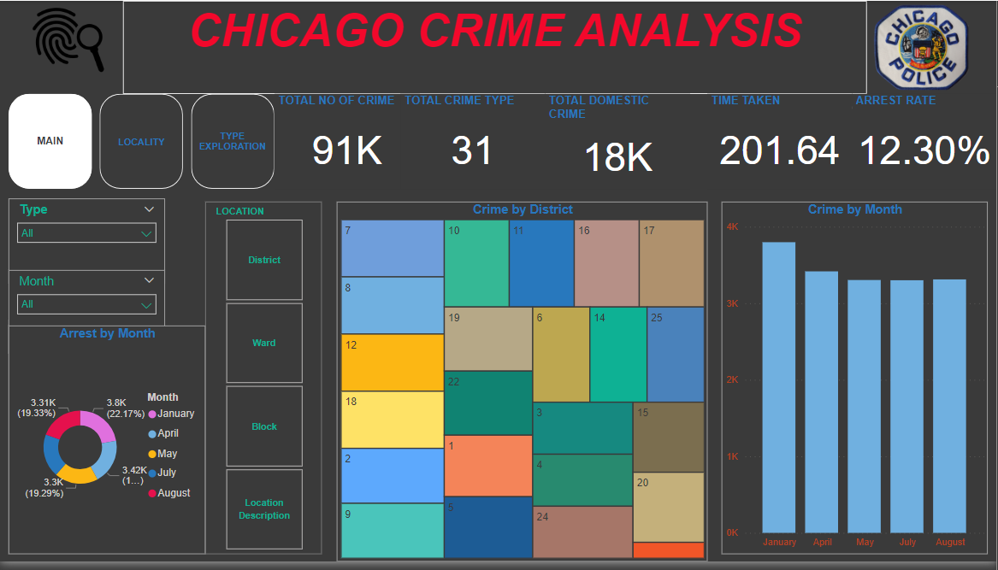

Slide 13
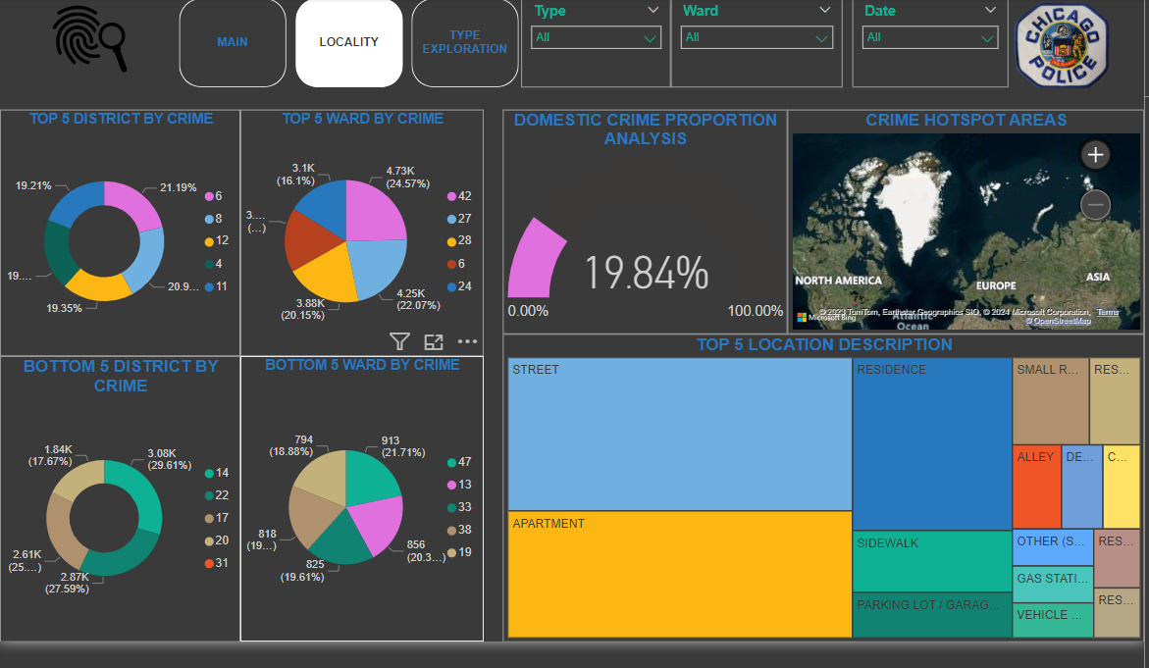

Slide 14
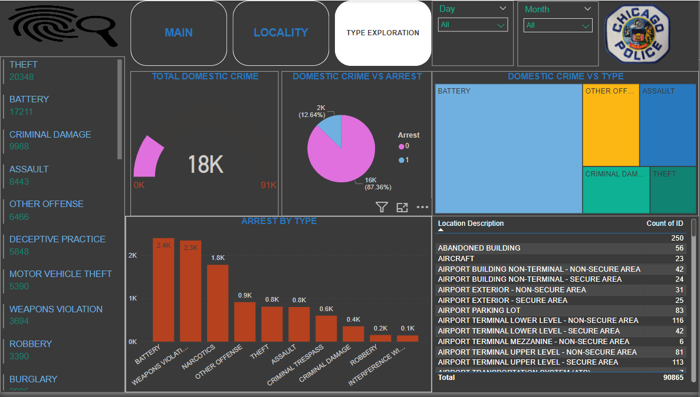

Slide 15

By PAVITHRA M

